Slide 1
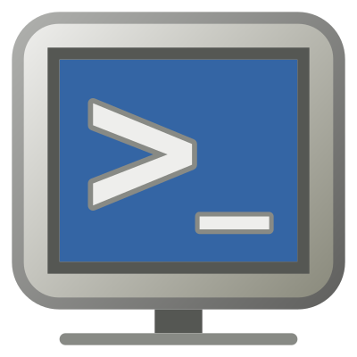
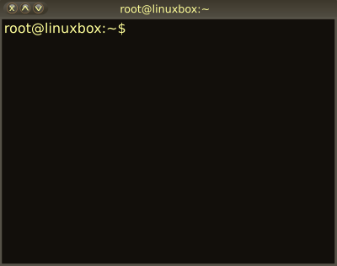

05 – Basic Unix System Administration
COMP 190 – Dickinson College
Fall 2021
Images from: openclipart.org

Slide 2
System Administration
VirtualBox Snapshots
Software Installation
Package Managers
Graphical Interface
Command Line Interface
The Super User
Users and Groups

Slide 3
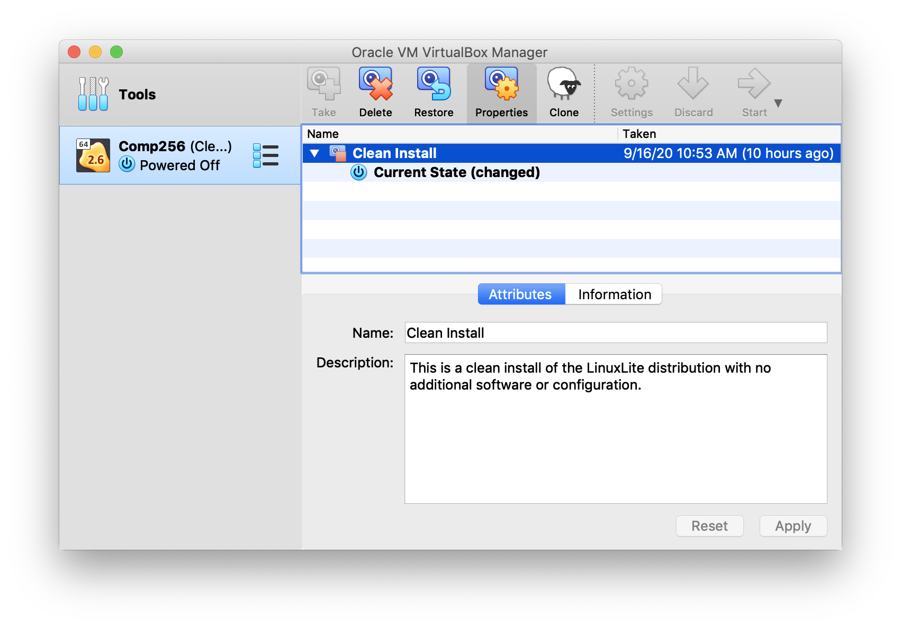
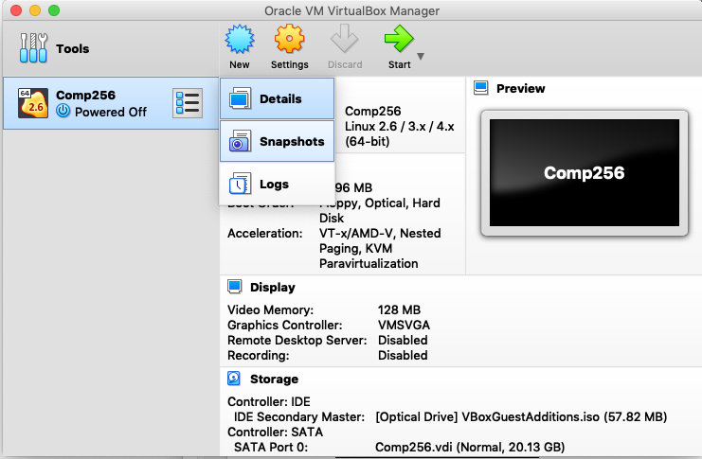
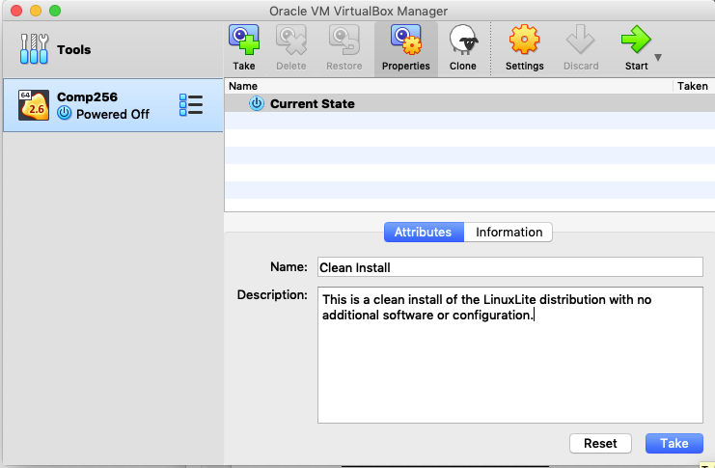
VirtualBox Snapshots
A snapshot is a backup of your virtual machine that will allow you to restore it to a known (hopefully functional) state.
Notes:
Each snapshot takes up some space on your host disk drive.
So keeping lots and lots of snapshots can take up a lot of space.
Often will be good to delete old snapshots that you don’t need any more.
- i.e. take some as you move through a process at key points
- but then delete all but the last one
- Or take one at the start, then mess around until you know how to do what you want to do correctly.
- then do it from the snapshot
- then take another one and maybe delete the first one.
Great for when you mess stuff up!!!

Slide 4
Software Installation
A package manager is a tool to simplify installing software and managing its external dependencies.
System-Level Package Managers
apt, rpm, yum, pacman, brew, snap
Project-Level Package Managers
JavaScript npm
Python pip conda
Java maven gradle
Notes:
Apt – advancd packaging tool
Rpm – redhat package manager
Yum – yellowdog updater – modified
Pacman – archlinux
Brew – macOS
Snap – linux
For now we’ll focus on system software package manager
We will use APT the Synaptic Package Manager
It is a really good one and is what is the default on Ubuntu, Debian, LinuxLite
Maybe later we’ll look at one for a specific project…

Slide 5
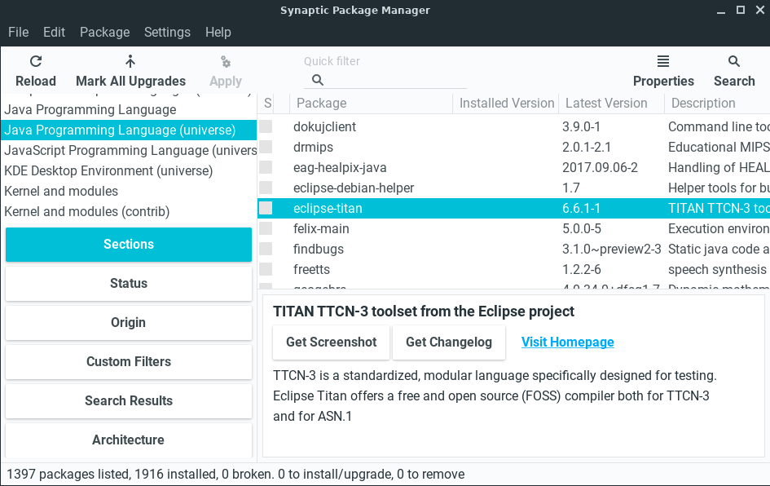
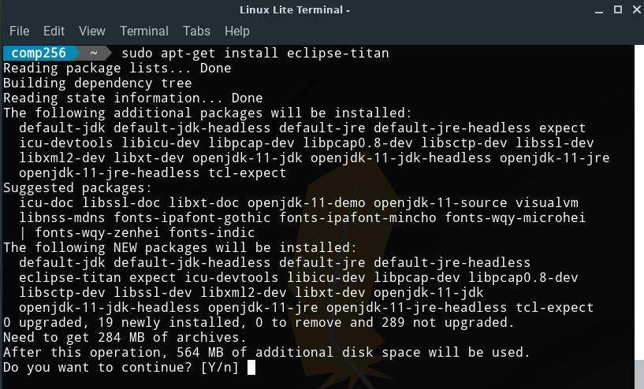
apt & Synaptic Package Manager
Notes:
Like CLI and GUI File manager …
APT and Synaptic are different interfaces to the same thing
APT is a command line tool
Synaptic Package Manger is a GUI too.

Slide 6
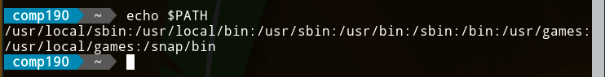
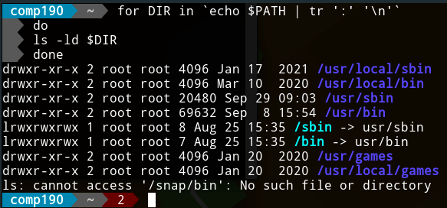
Software Installs & Permissions
Recall the PATH Environment Variable
Notes:
What is PATH?
- List of directories in which the shell will look for executable programs.
These are also directories where software is installed.
So to install software…
- must have write permissions to those locations
But…
- Only root has write permission to those locations.
NOTE: The /sbin and /bin are “links” which are like shortcuts or aliases.
- the write permission there just indicates that anyone can use the link (i.e. cd using it)

Slide 7
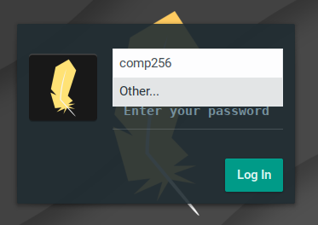
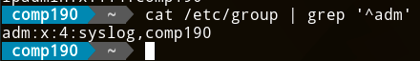
Super User (root) and sudo
Unix is a multi-user system
root is the name of the super user
Permissions checking disabled
Cannot log in - security
sudo runs commands as the super user
E.g. sudo apt install apache2
Members of the adm group have sudo privileges
User added during install is added to adm.
Notes:
A multi-user system means
- multiple accounts
- different users can log into the same system (think servers and shared computers)
- different users will have different permissions
- Don’t want everyone being able to change system settings.
Permission checking is essentially disabled for the root user.
- Can perform any operation on any file.
- For security reasons the root user cannot log in directly.
The sudo command will execute a commands as if it were run by the super user (root).
- Thus using sudo overrides the permission system
- Allows users with permission to use sudo to administer the system.
Permission to sudo is controlled by being a member of the adm group.
- The first user created during install is automatically added to the admin (adm) group.
- This would have been the user you created when you logged in.
Example:
- If you were setting up a machine for multiple people to use (e.g. in a lab)
- Then your user would be in the adm group
- But the users you create for others would not be in the adm group
- They might be in a users, staff or student group,
- Which could then be assigned different privileges

Slide 8
What’s Next?
A05 / Q05 – Due 1 week
Revise and Resubmits (A01– A04)
Prepare for Reading and Discussion

Slide 9

Acknowledgments:
Slide Template From:
https://creativecommons.org/licenses/by/4.0/
Slide Content Licensed as:
https://creativecommons.org/licenses/by-nc/4.0/

